Slide 1
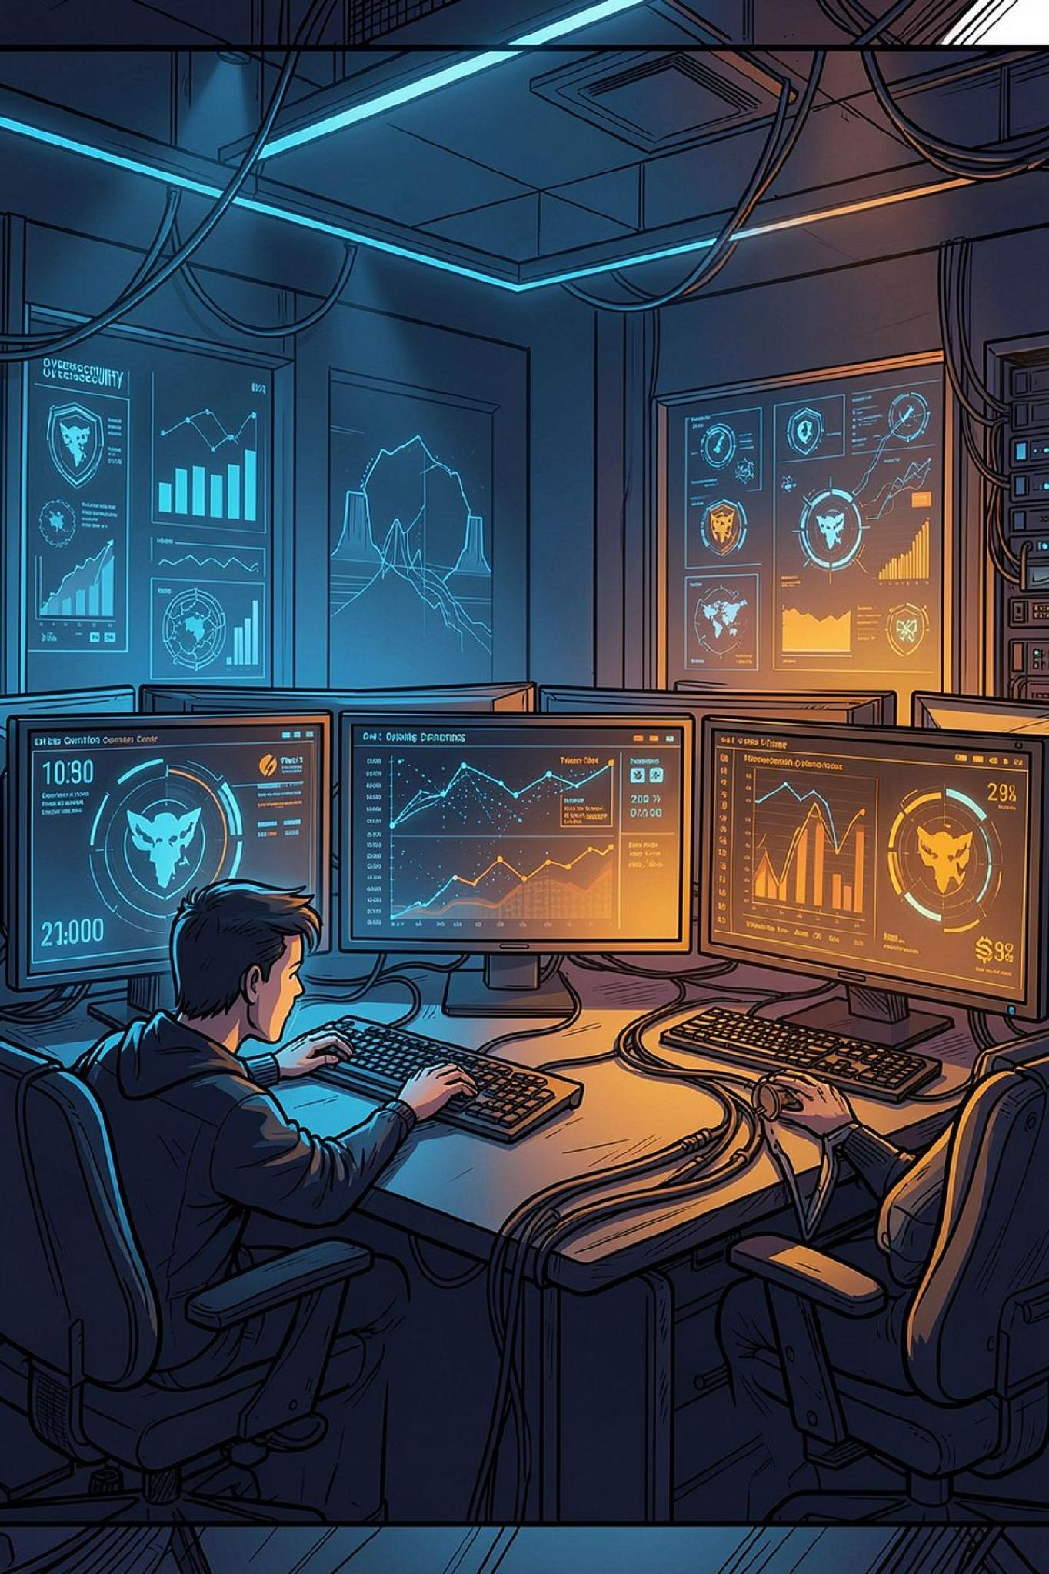
Threat Intelligence Correlation & Alert Prioritisation Assistant
From raw alerts to actionable intelligence
Presented by: Sejal Lathigara, Snehal Mishra, Raj Joshi, Mahek Trambadia
CHALLENGE
Correlate multi-source alerts, identify real threats, map activity to MITRE ATT&CK, and generate concise BLUF summaries.

Slide 2
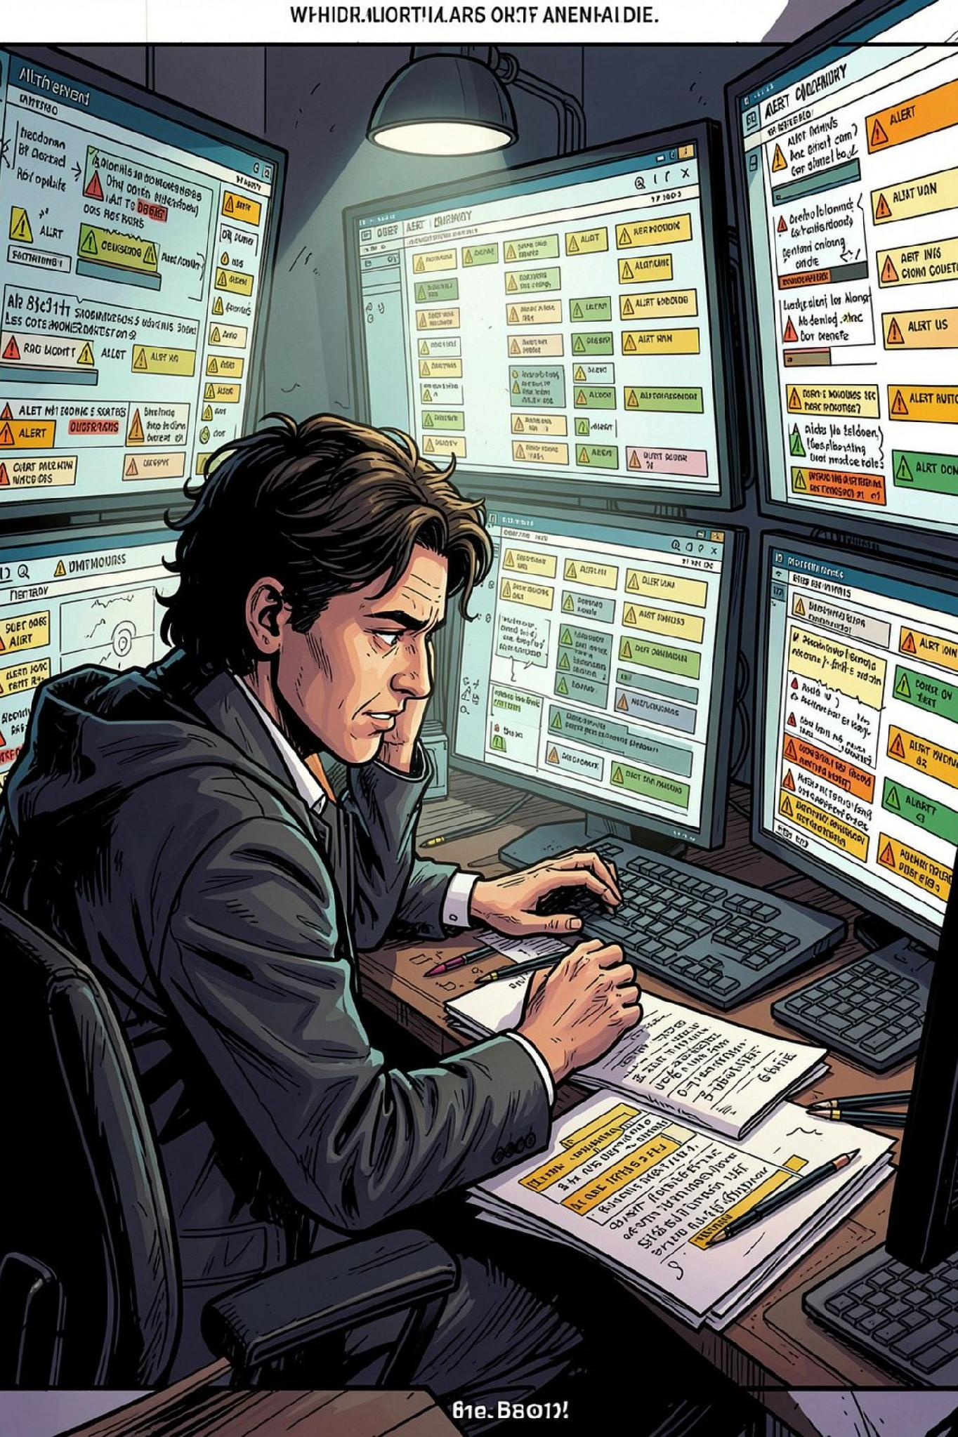

Security Teams Face Alert Overload
Volume
Noise
SIEM, EDR, IDS, firewall, WAF, proxy, and threat feeds generate too many alerts.
Duplicates and related events hide real attacks.
Manual Effort
Analysts spend too much time triaging logs instead of assessing threats.
Core Problem: Turn scattered alerts into correlated incidents, prioritized threats, and actionable intelligence.

Slide 3






Proposed Solution: Correlation Engine
End-to-end alert prioritisation — from raw ingestion to commander-ready intelligence.
Ingest
Correlate
Prioritize
Upload CSV alerts.
Group by IP, host, time, behavior.
Score risk and rank by severity.
Map
Summarize
Link to MITRE ATT&CK.
Generate a BLUF brief.
Goal: Less noise, sharper focus, faster response.

Slide 4
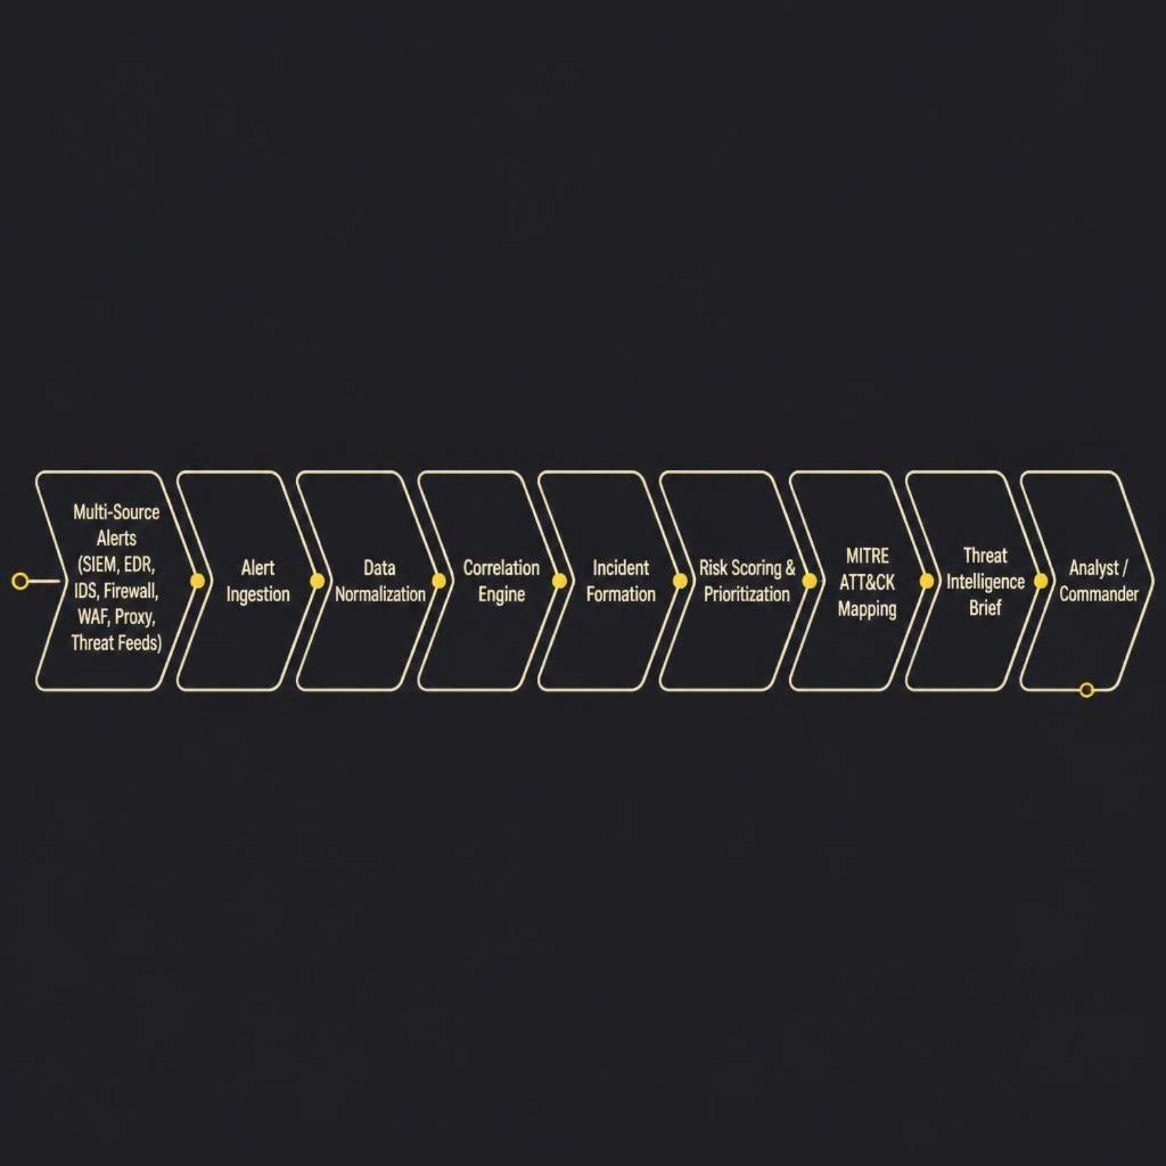
System Architecture
Input Sources
SIEM / EDR
IDS / Firewall
WAF / Proxy
Threat feeds
Raw alerts become prioritized intelligence for analysts and commanders.

Slide 5
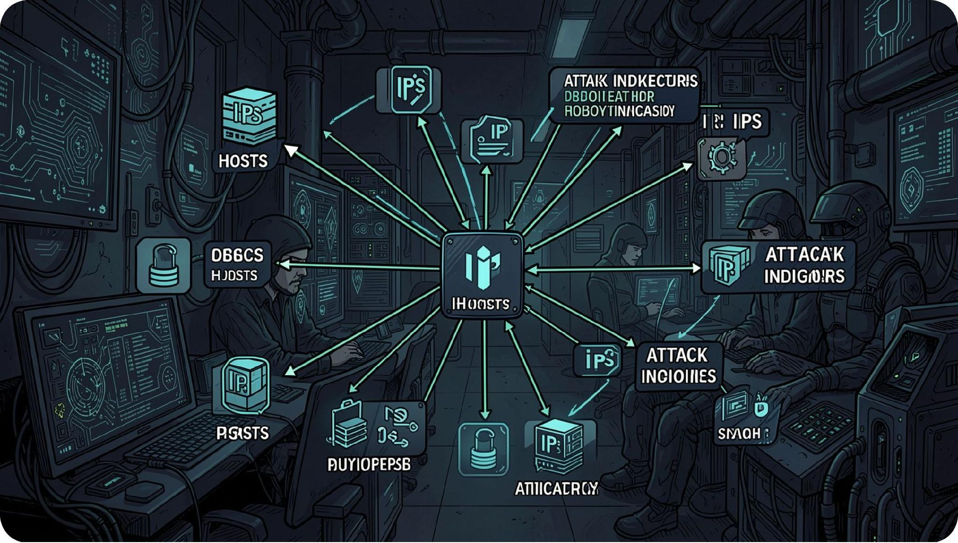



Alert Correlation Engine
How Related Alerts Are Detected
Shared Indicators
IP, host, user, timestamp.
Behavior Match
Same tactic, similar malware, shared infrastructure.
Time Correlation
Events in the same attack window.
Example: Port scan → C2 → malware → credential dump → ransomware = one incident

Slide 6

Risk Scoring & Prioritisation
INC-001 — Risk Score: 85 — HIGH
Scoring Factors
Severity
Related alerts
Malware
C2 communication
Scanning
Credential theft
Detection sources
+40
+10
High severity
3 related alerts
+20
+15
Ransomware
C2 traffic
+10
+5
Result: Critical threats surface first.
Network scanning
Multiple sources

Slide 7
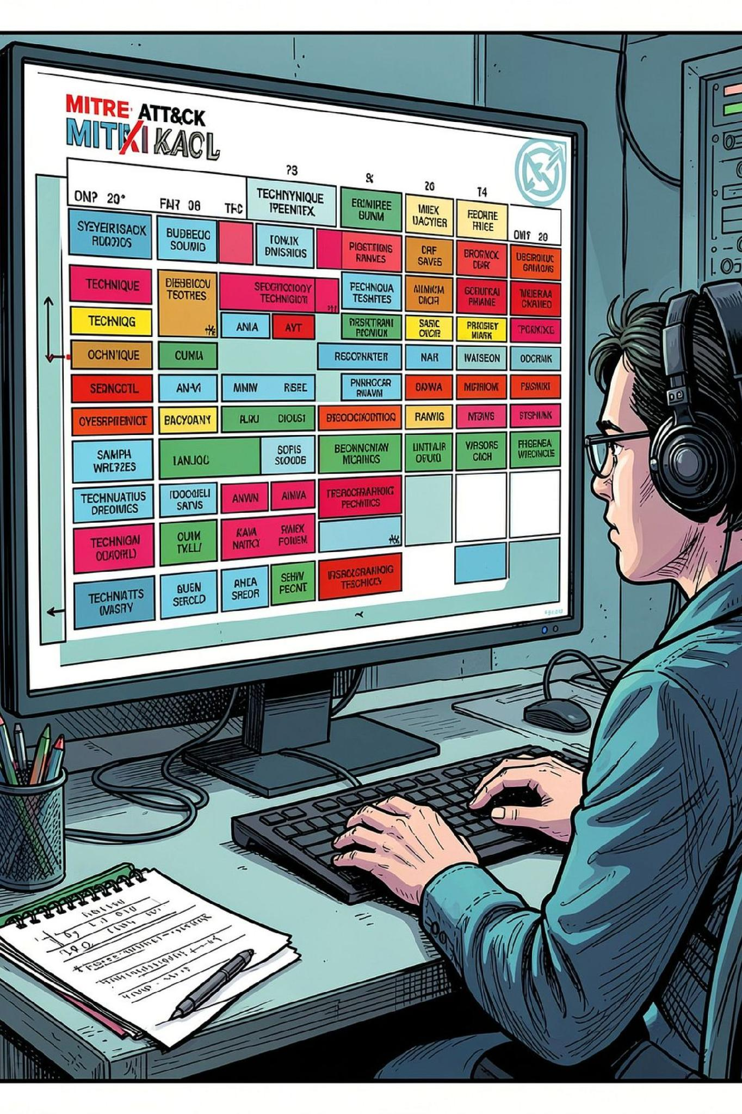

MITRE ATT&CK Mapping
Behavior is mapped to standard adversary techniques for clearer investigation and threat hunting.
T1071 — App Layer Protocol
Command and Control
T1046 — Network Discovery
Discovery
T1486 — Data Encrypted
Impact
T1595 — Active Scanning
Reconnaissance

Slide 8
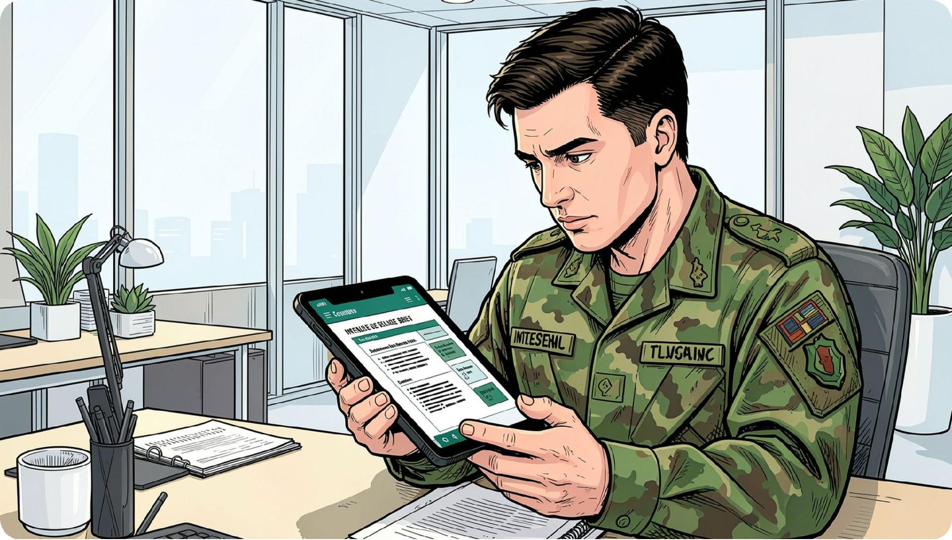

BLUF Intelligence Generation
Bottom Line Up Front
Turns raw alerts into a concise brief so commanders understand the threat in seconds.
Threat
Affected Asset
Evidence
MITRE Techniques
Possible ransomware with C2 and reconnaissance activity.
File server or workstation — Critical / High
Port scan, C2 traffic, ransomware signature, malware activity.
T1071, T1046, T1486, T1595
Recommended Action
Isolate host. Block infrastructure. Hunt for lateral movement and credential theft.

Slide 9
Prototype Results & Dashboard
20
7
1
Alerts Ingested
Correlated Incidents
Critical
3
3
High
Low
INC-001 Highlights
UI Capabilities
Risk score: 85
3 related alerts
Ransomware + C2 activity
MITRE mapping
Intel brief generated
CSV upload and correlation
Prioritization and filtering
Threat vs. false-positive classification
Incident expansion and brief generation

Slide 10
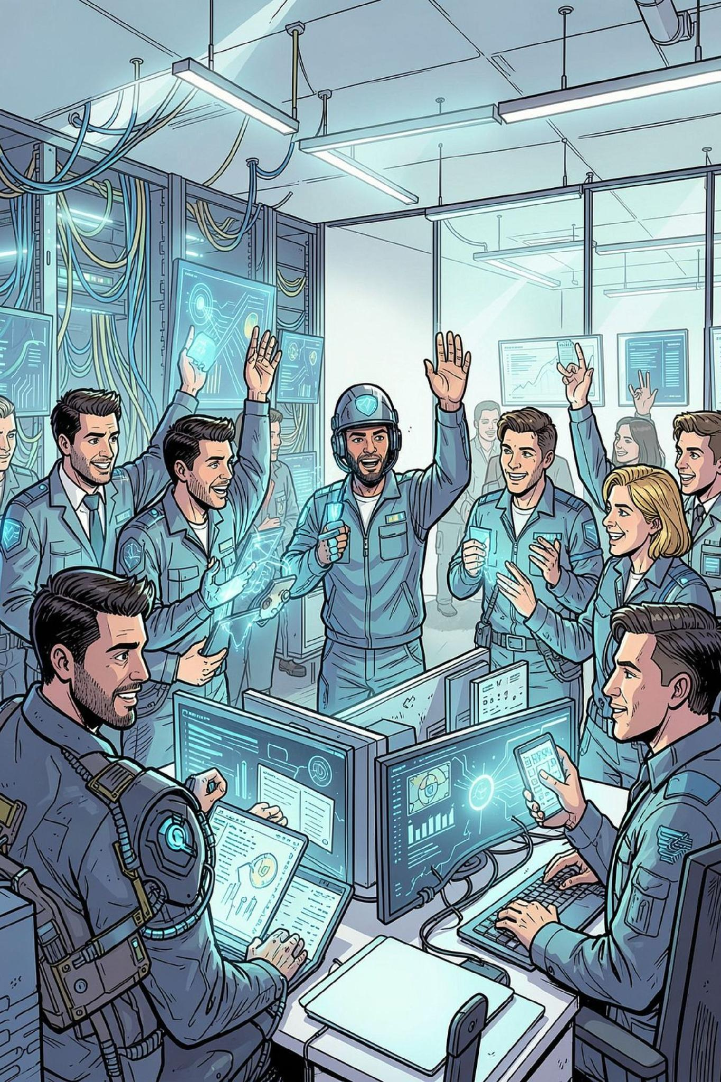
Impact & Future Scope
For Analysts
Less fatigue, faster triage, better context.
For Commanders
Clearer picture, prioritized incidents, faster decisions.
Future Scope
SIEM + STIX/TAXII integration
IOC enrichment + anomaly detection
SOAR-driven containment
Historical campaign correlation
"From Alert Overload to Decision-Ready Intelligence."

